Slide 1
Object Oriented Analysis And Design
Project : Website VnUni

Slide 2
Instructor A. Prof Truong Ninh Thuan
Members :
Trương Quốc Tuấn
Lê Văn Giáp
Nguyễn Thạc Thống

Slide 3
References
Restaurant Manager Software Document K55CA
IBM Rational Software Document
Object – Oriented Analysis and Design Textbook
(Truong Ninh Thuan – Danh Duc Hanh)

Slide 4
Outline
Introduction / Requirements
Analysis
Design
Implementation and Demo

Slide 5
Introduction / Requirements

Slide 6
Introduction / Requirements
Problems:
There are millions of high school students constantly taking university entrance examination every year in Vietnam.
Many kinds of handbooks and websites are being published. However, these sources are sometimes not reliable; the interface is not friendly and unscientific.

Slide 7

Introduction / Requirements
Solution:
We want a useful website called VnUni for students to help them approach easily the necessary information about universities and colleges by a brand-new way.

Slide 8
Introduction / Requirements
Description:
Provides an information search engine based on different filters: location, majors, recently admission marks.
Ranking & Rating System : rate schools.
Each university or college is supplied with a separate account to log in the system to modify their data.
This website must have an administrator that manages all operations of the system: add/remove a school, add/remove a user, modify database.
Notes:
Anonymous users must not have the privilege to register a new school account. It is only provided by administrator.

Slide 9
Introduction / Requirements
Glossary terms:
University
University Admission
Entrance Exam
Faculty
Admission mark
Admission staff
Filter Catalog
User
Admin
Notes:
University
An education organization in Vietnam.
University Admission
An activity of universities to admit students.
Entrance exam
An exam of Vietnam universities for graduated high-school students who want to
get higher education.
Faculty
A group of university departments concerned with a major division of knowledge.
Admission Mark
A level of mark for students to take to the university.
Admission Staff
An user of the university who has the permission to edit the information page of
this university.
Filter Catalog
The fields catalog of filter system, helping user to filter out suitable universities
quickly.
User
A person who view the website in their browser.
Admin
A person who develop, maintain the system and update database.

Slide 10
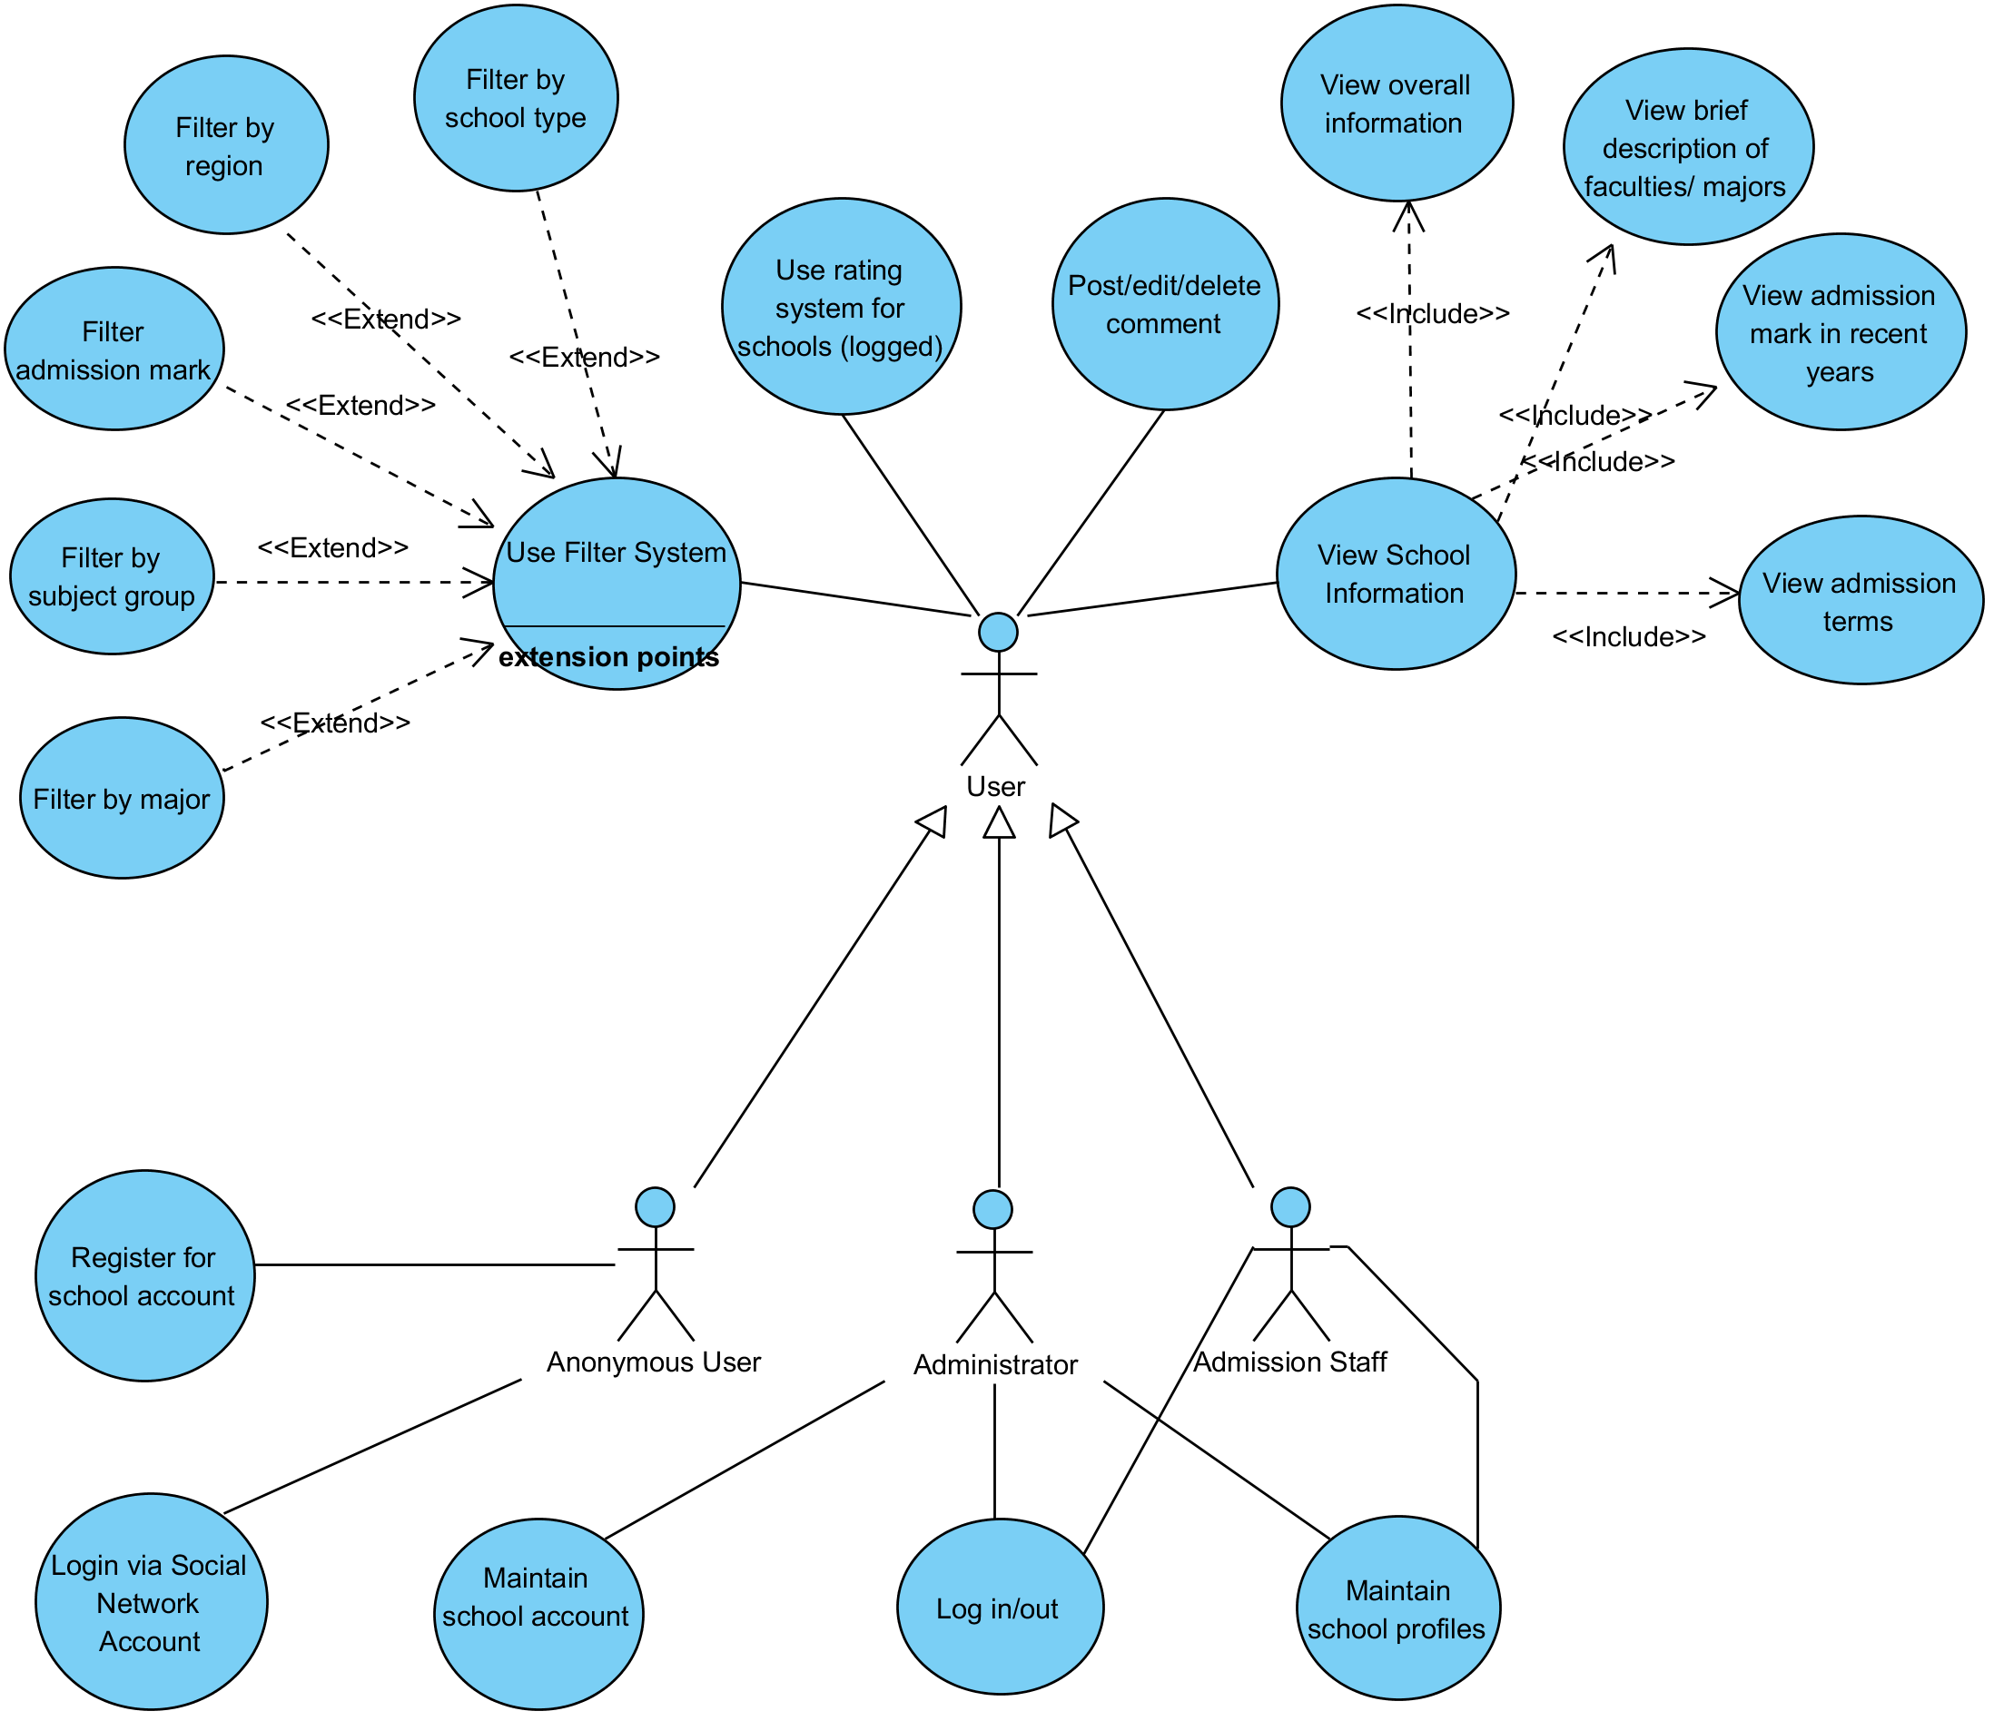
Introduction / Requirements

Slide 11
Introduction / Requirements
Use-case Specification
<Login>
This use case describes how a user logs into the VnUni System
<Maintain School Profile>
This use case allows the Administrators and Admission staffs to maintain school information

Slide 12
Introduction / Requirements
Use-case Specification
<Use Filter System>
This use case describes how a user use the filter system to search universities.
<View School Information>
This use case allows any users to see the information of a school.
Notes:
<View School Information>
The information contains: full name of school, date of established, short introduction, etc.

Slide 13
Introduction / Requirements
Use-case Specification
<Register School Account>
This use-case allows anonymous users to send a request to administrator to get an account for him/her school.
<Maintain School Account>
This use case allows the Administrators to add or remove accounts for schools.
Notes:
<Register School Account>
After receiving the request, admin will examine the
information, accept or reject the request and send the response to users via email.

Slide 14
Introduction / Requirements
Use-case Specification
<Use Rating System>
This use case allows the logged users using rating system to rate a specific school.
<Post/Edit/Delete Comment>
This use-case allows any user to post, edit or remove comments for a articles or a schools in this website.

Slide 15
Analysis

Slide 16
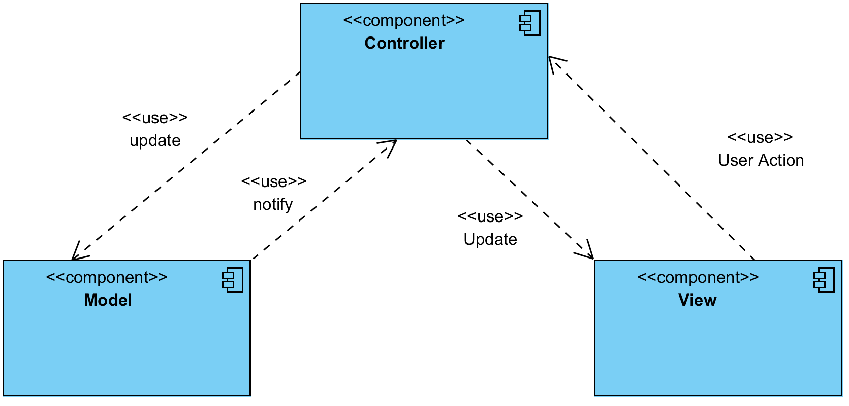
Analysis
Architectural Analysis
Logical View
Notes:
Model: represents the underlying, logical structure of data in a software
application and the high-level class associated with it. This object model does not
contain any information about the user interface.
• View: This is a collection of classes representing the elements in the user interface
(all of the things the user can see and respond to on the screen, such as buttons,
display boxes, and so forth)
• Controller: represents the classes connecting the model and the view, and is used to
communicate between classes in the model and view.

Slide 17
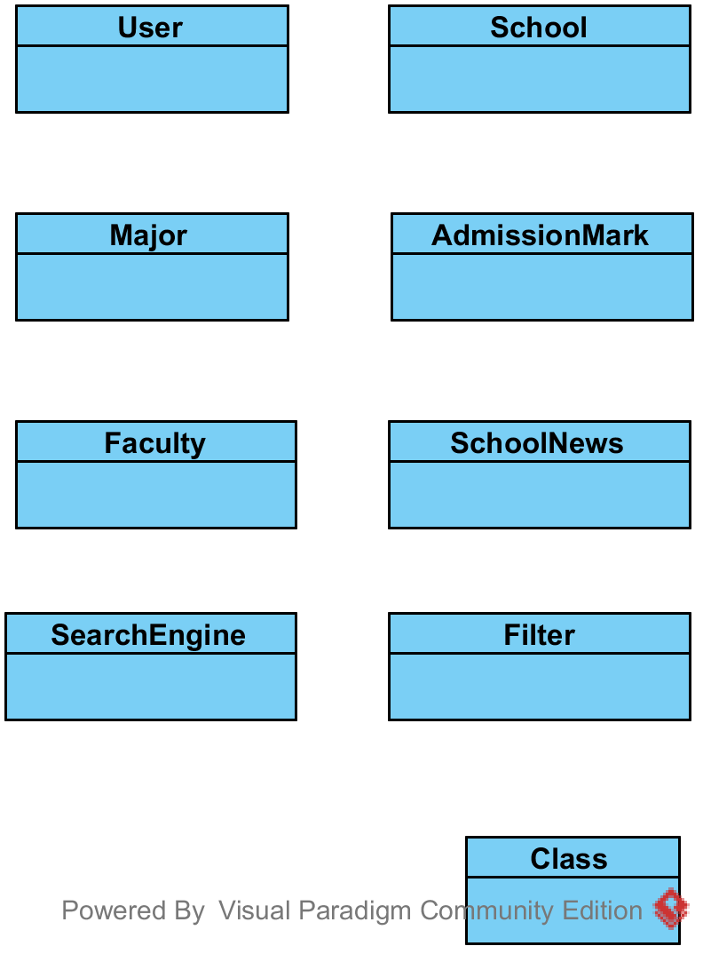
Analysis
Architectural Analysis
Key Abstractions
Notes:
Definition
• User: Is an account of the system, may be an normal user, school user or
administrator.
• School: A record that contains all information about school information.
• Major:A record that contains all information about a school major.
• Division:A record that contains all information about a division in university
entrance exam.
• AdmissionMark: A record that contains admission mark of specific year of a school
major.
• SchoolNews : The article was written by the school user or administrator, contains
contents about useful school news.
• SearchEngine:The component that is responsible for searching all information
about schools’ information.
• Filter: The component thatprovides specific options for user to quickly search
appropriate schools.

Slide 18
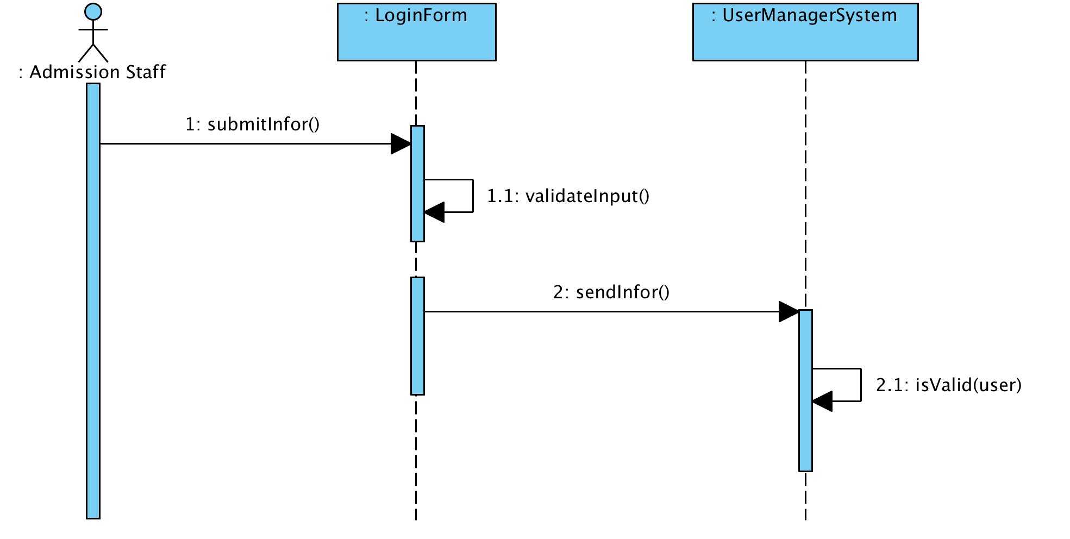
Analysis
Usercase Analysis : Interaction Diagrams
Login

Slide 19
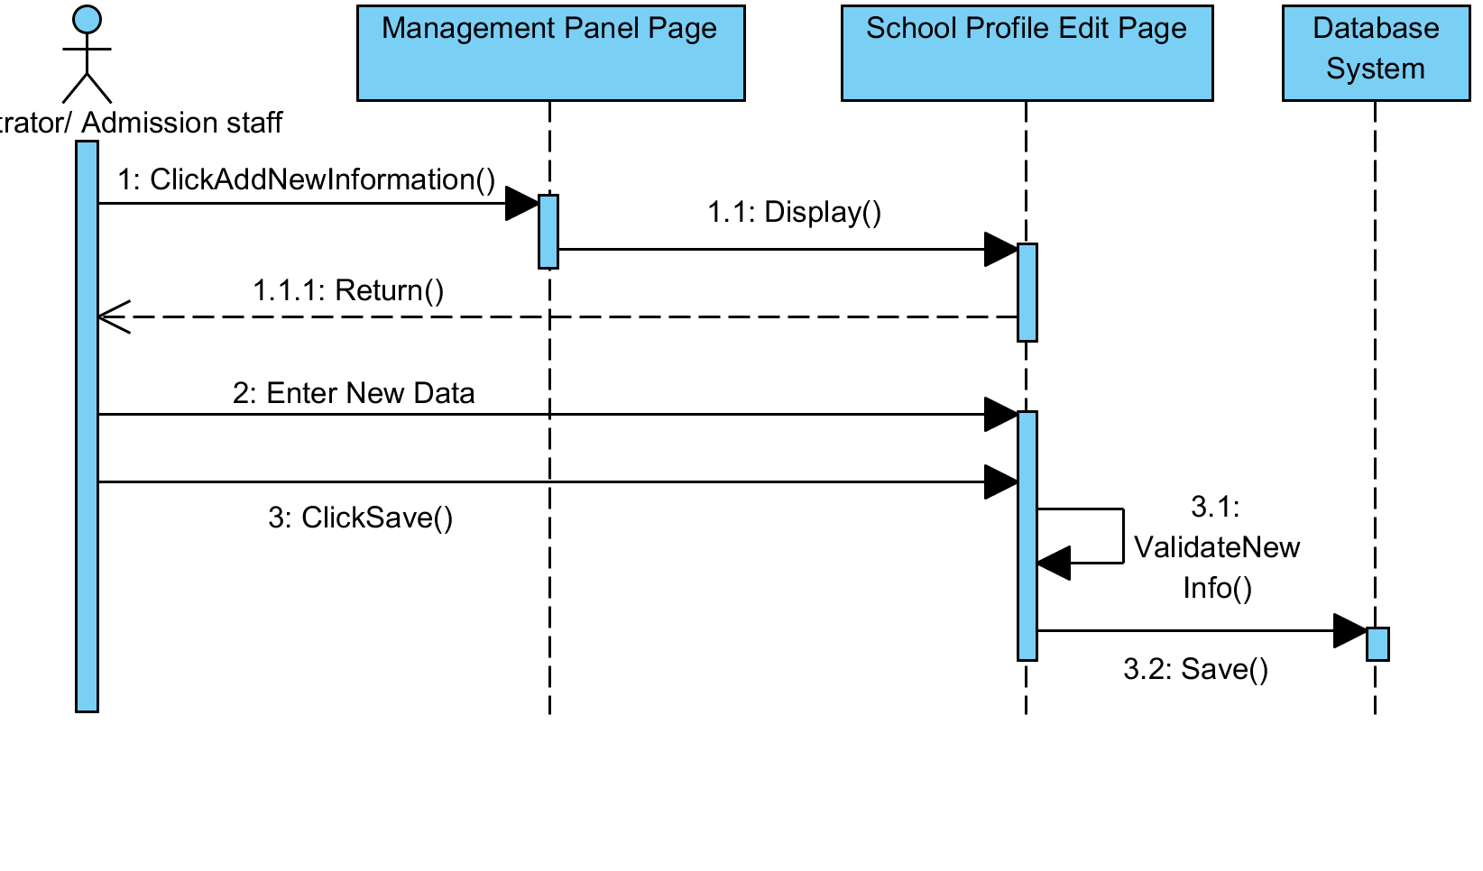
Analysis
Usercase Analysis : Interaction Diagrams
Maintain School Profile ( basic flow )
Notes:
Basic Flow

Slide 20
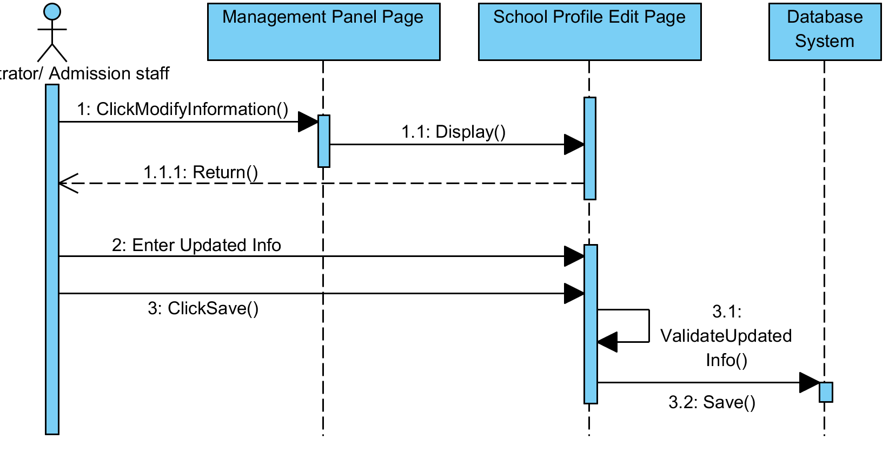
Analysis
Usercase Analysis : Interaction Diagrams
Maintain School Profile ( modify school profile flow )

Slide 21
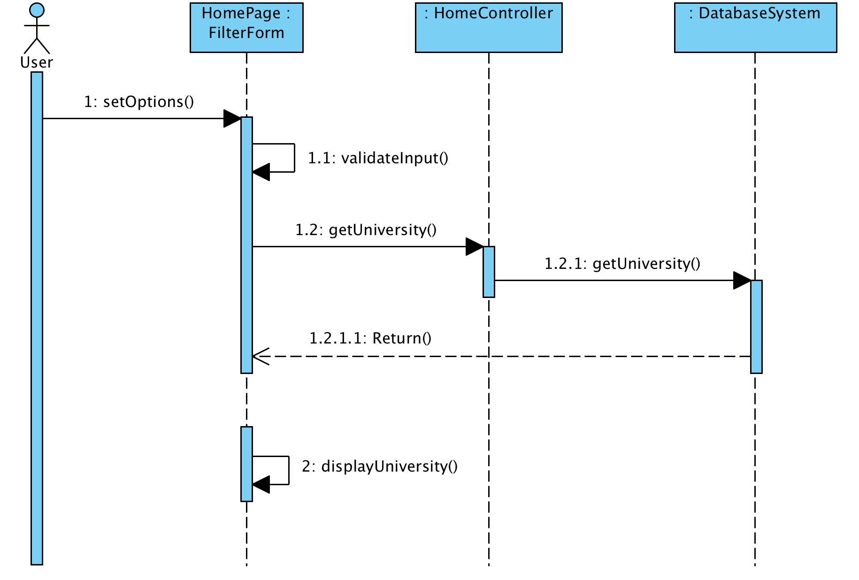
Analysis
Usercase Analysis : Interaction Diagrams
Use Filter System

Slide 22
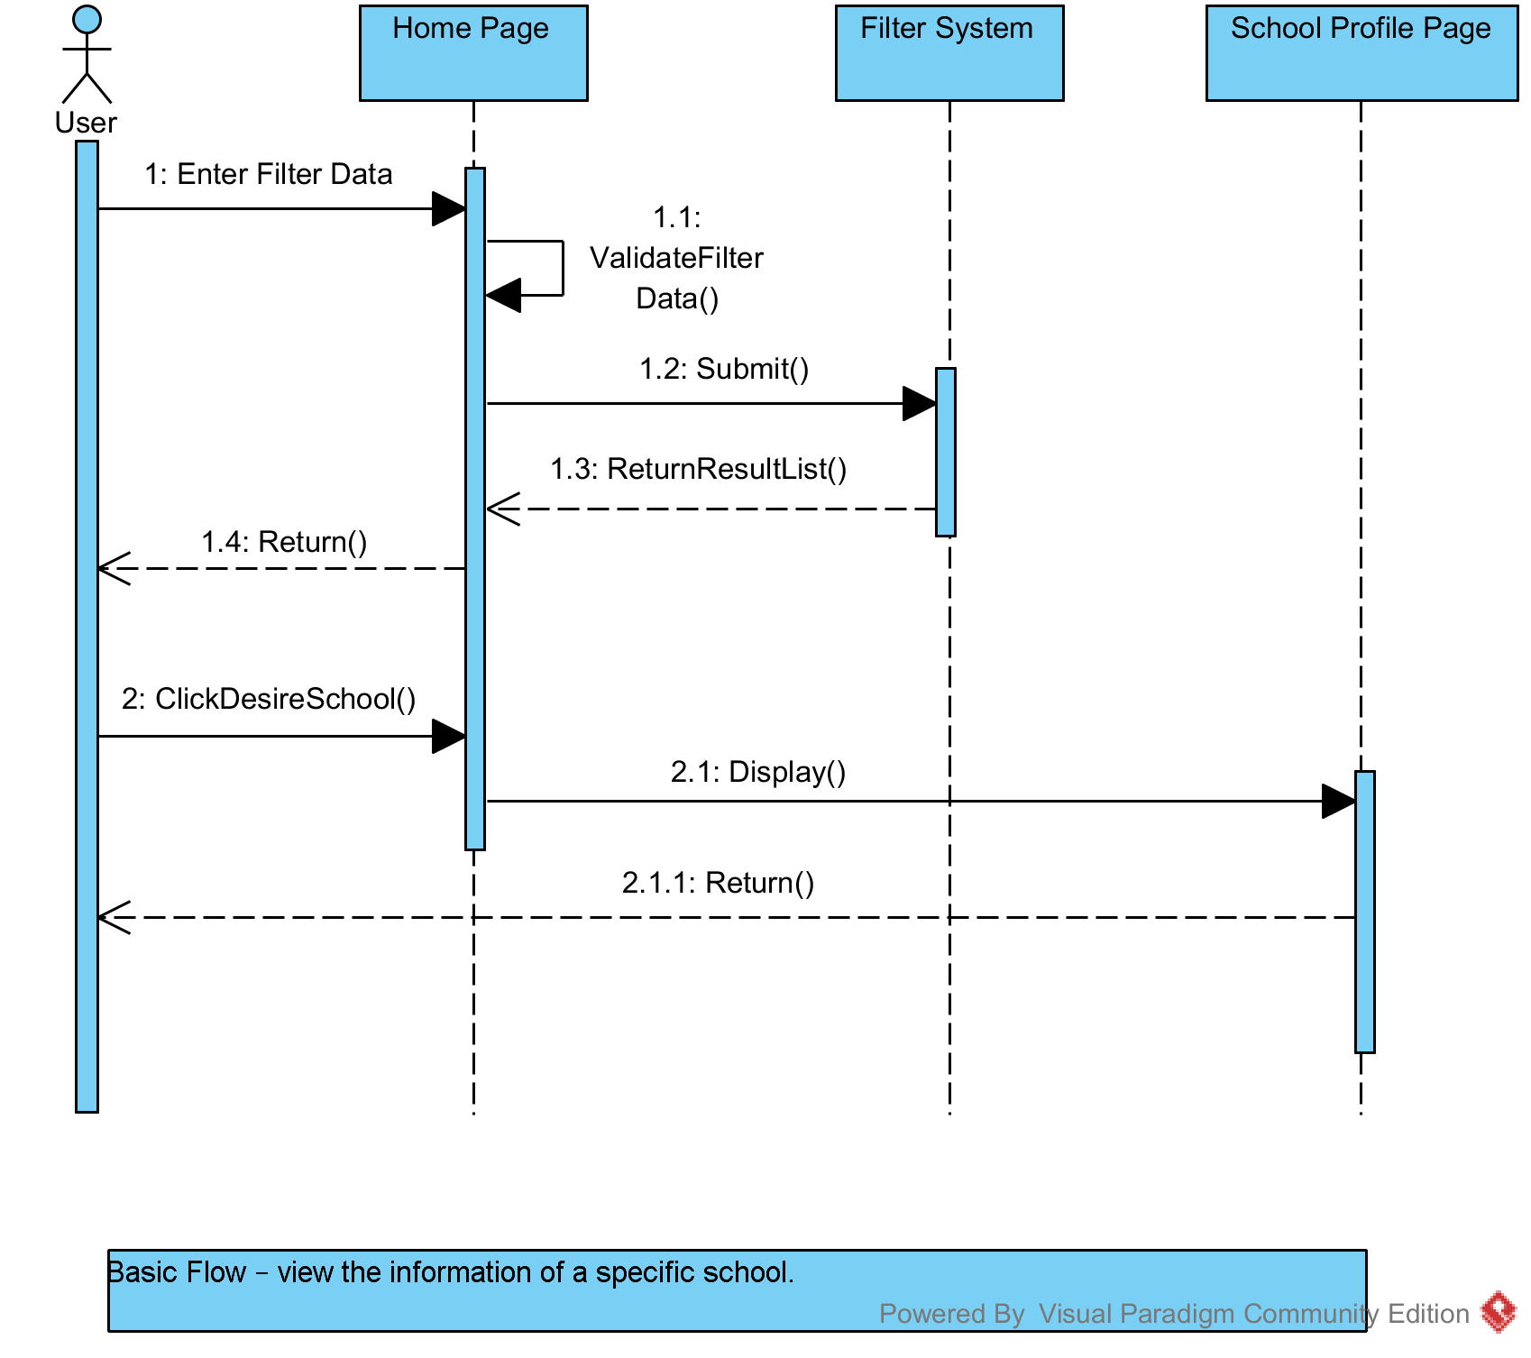
Analysis
Usercase Analysis : Interaction Diagrams
View School Information

Slide 23
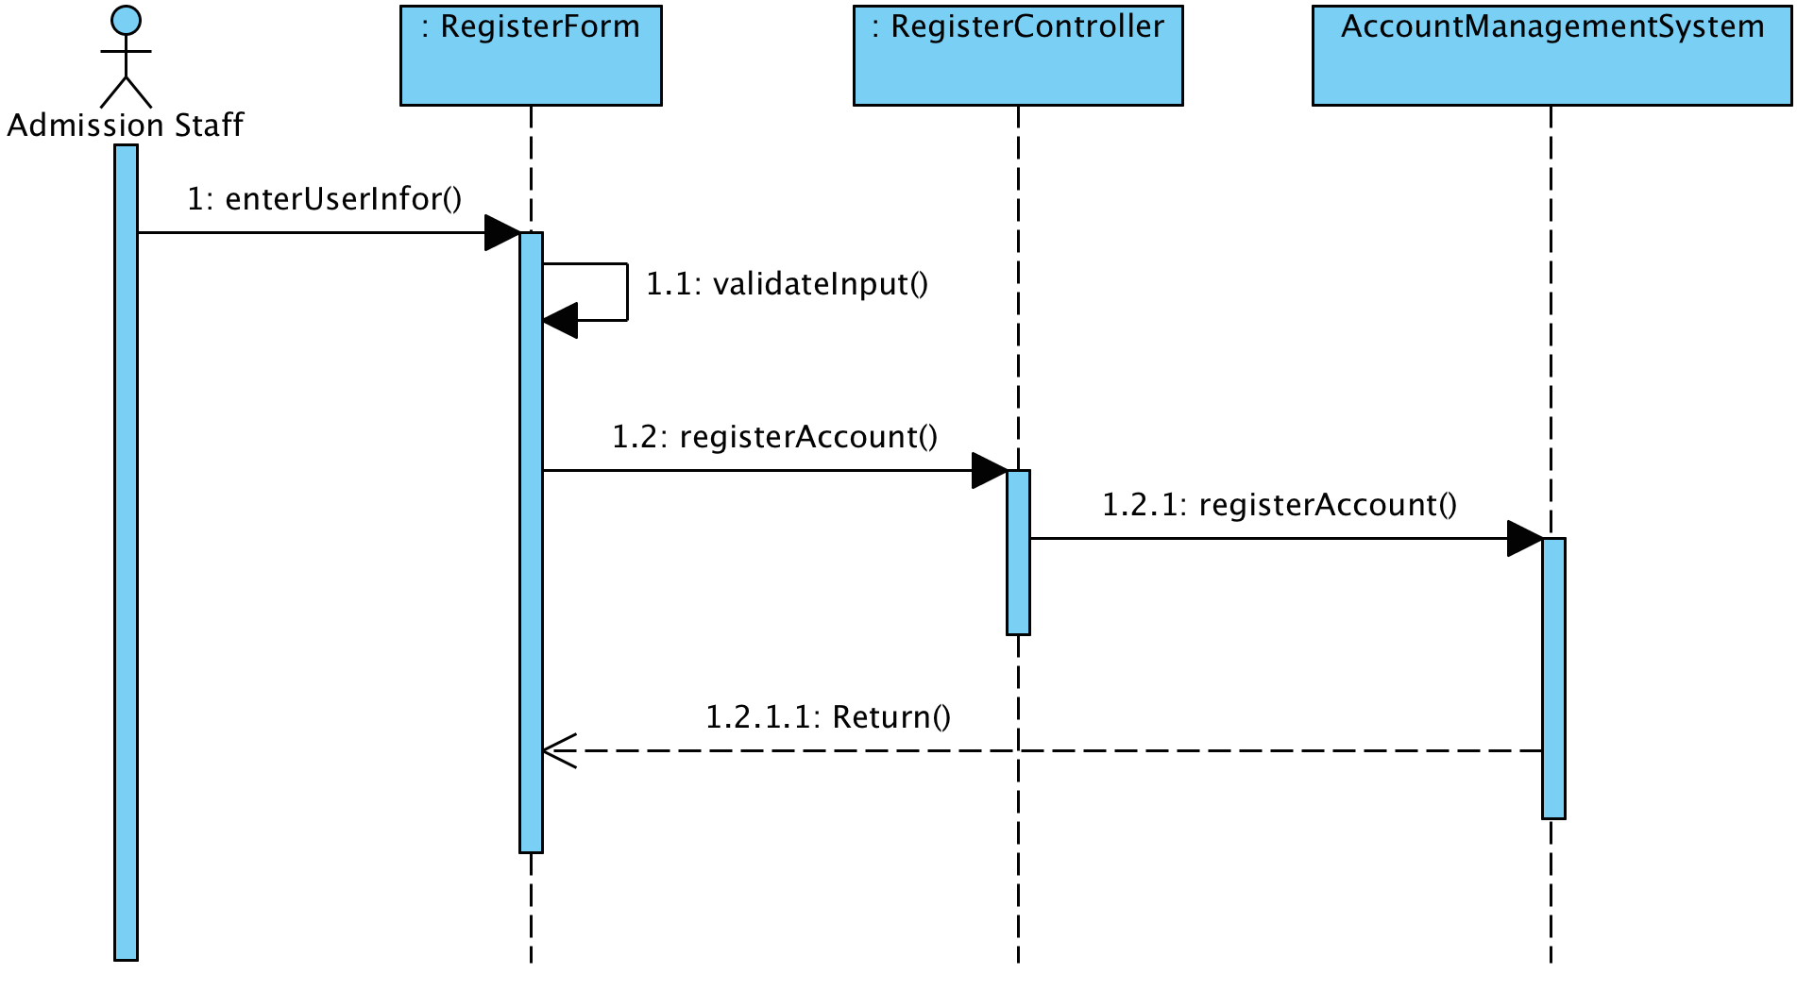
Analysis
Usercase Analysis : Interaction Diagrams
Register school account

Slide 24
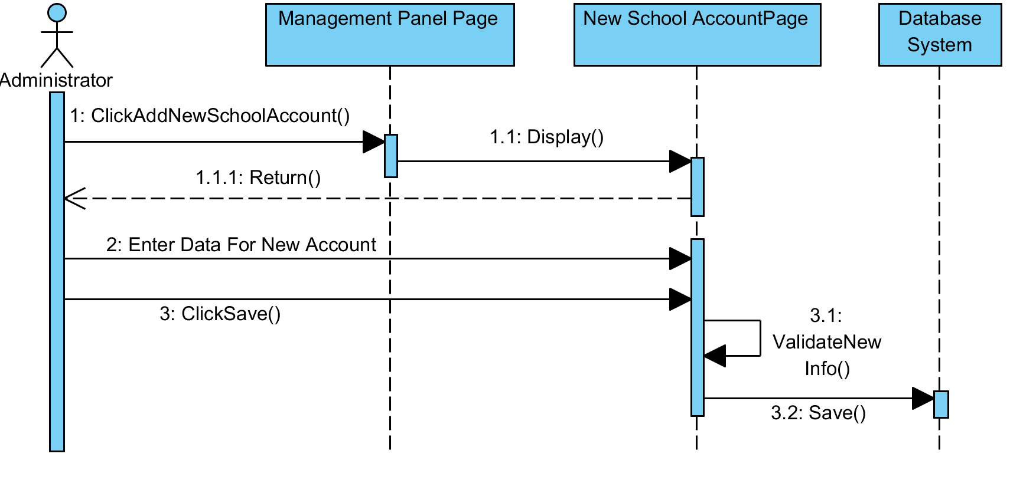
Analysis
Usercase Analysis : Interaction Diagrams
Maintain school account ( basic flow )

Slide 25
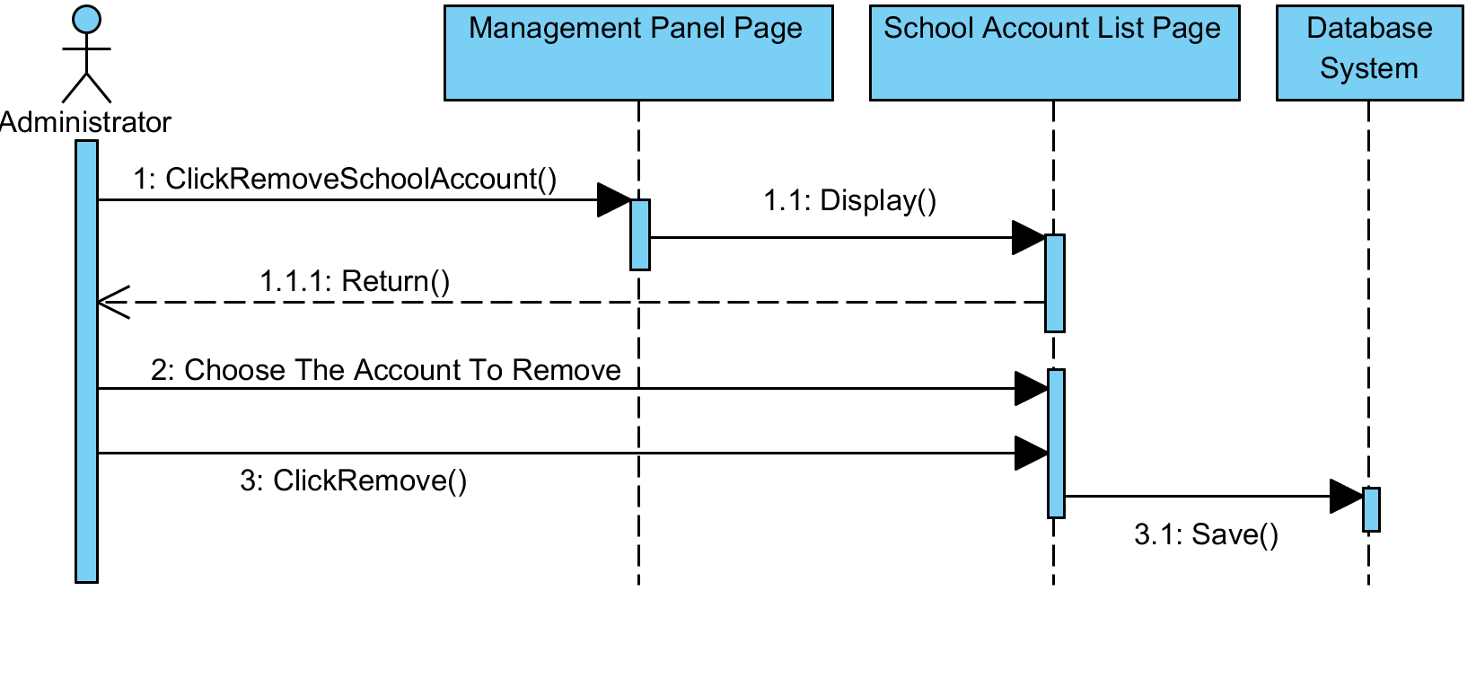
Analysis
Usercase Analysis : Interaction Diagrams
Maintain school account ( Remove Account Flow )

Slide 26
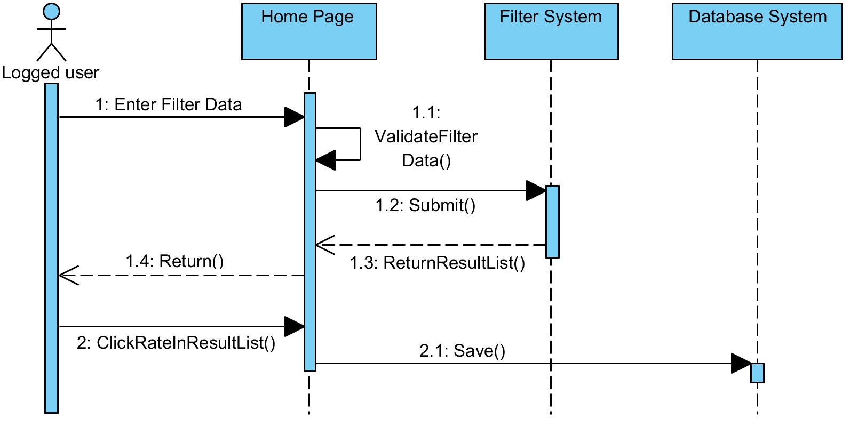
Analysis
Usercase Analysis : Interaction Diagrams
Use Rating System ( basic flow )

Slide 27
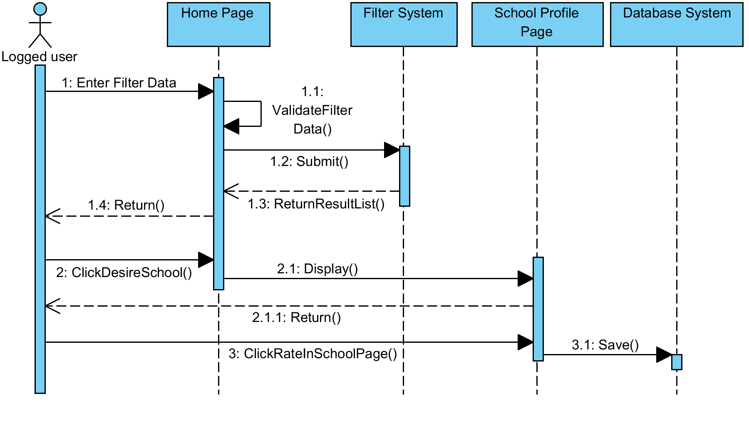
Analysis
Usercase Analysis : Interaction Diagrams
Use Rating System ( Rating In Uni Page Flow )

Slide 28
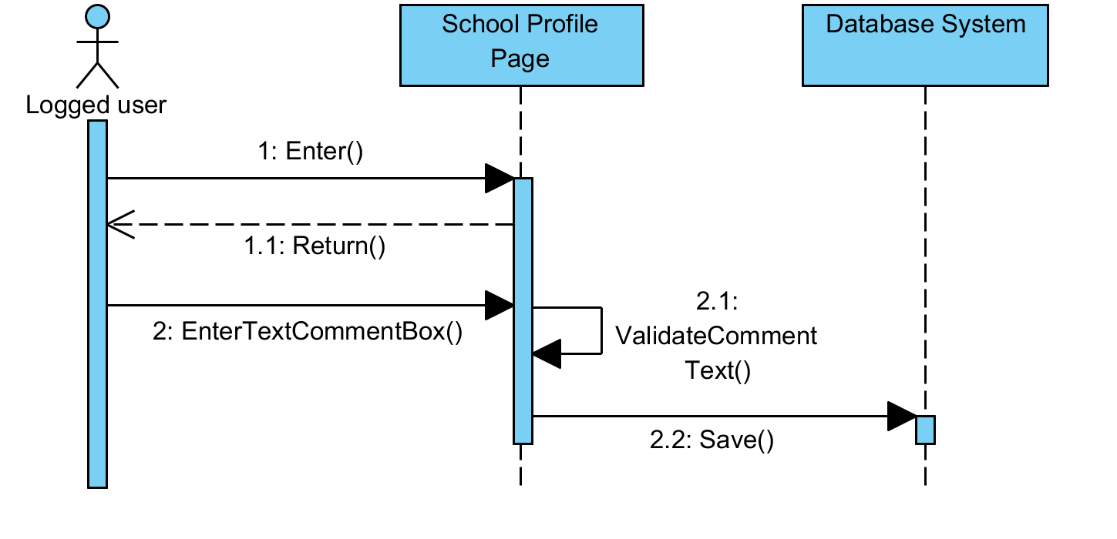
Analysis
Usercase Analysis : Interaction Diagrams
Post/Edit/Delete Comment (Post Comment Flow )

Slide 29

Analysis
Usercase Analysis : Interaction Diagrams
Post/Edit/Delete Comment ( Edit Comment Flow )

Slide 30
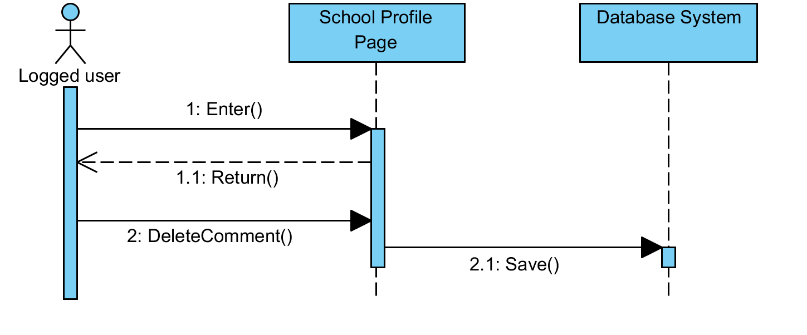
Analysis
Usercase Analysis : Interaction Diagrams
Post/Edit/Delete Comment ( Delete Comment Flow )

Slide 31
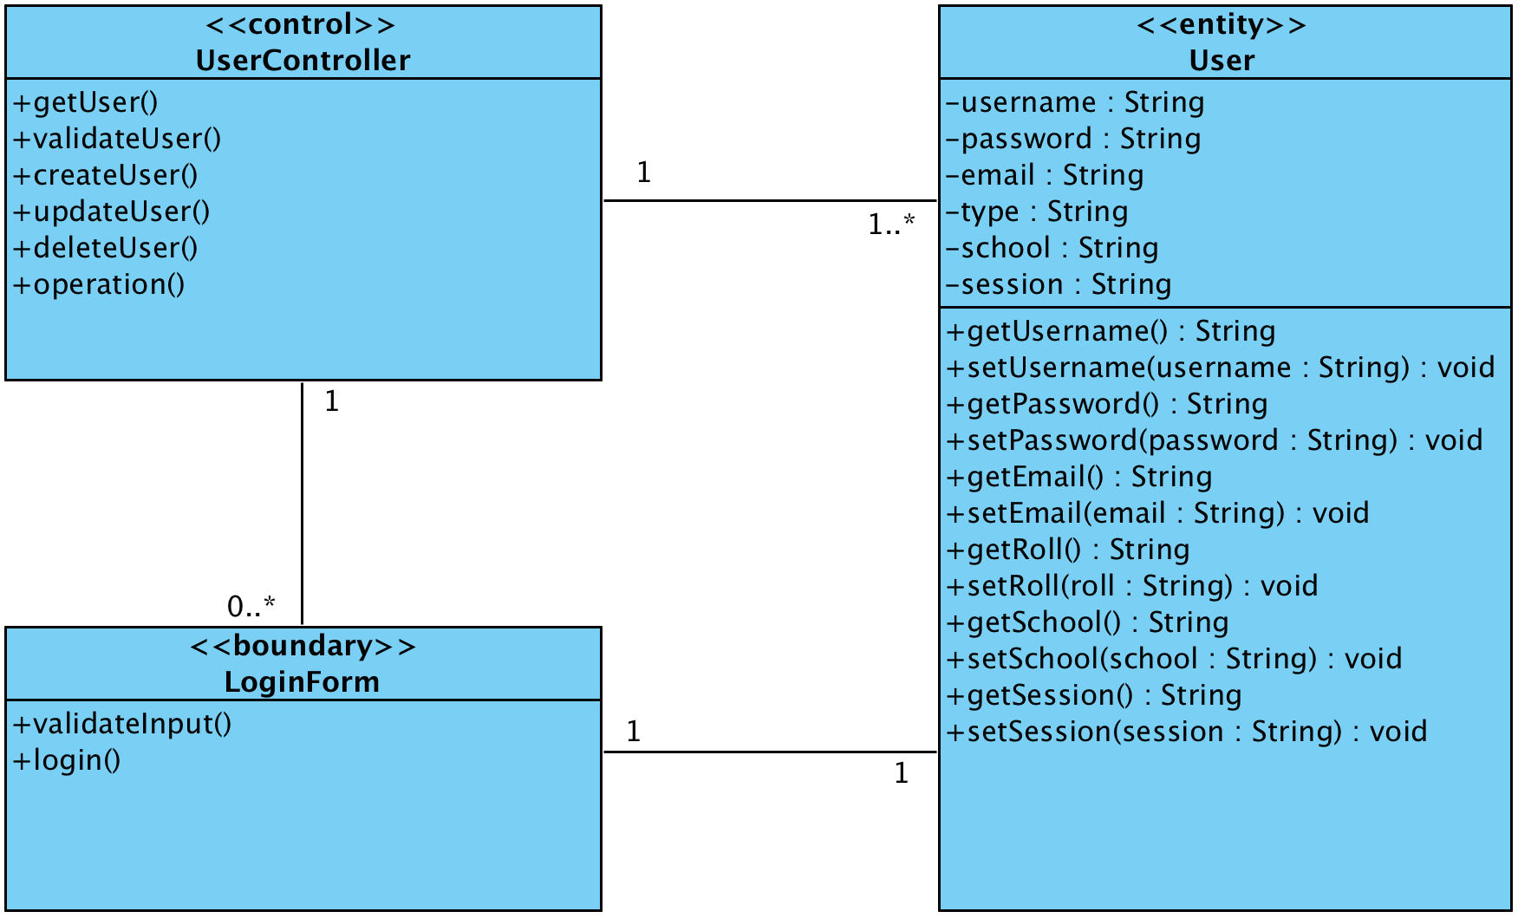
Analysis
Usercase Analysis : View Of Participating Class
Login

Slide 32
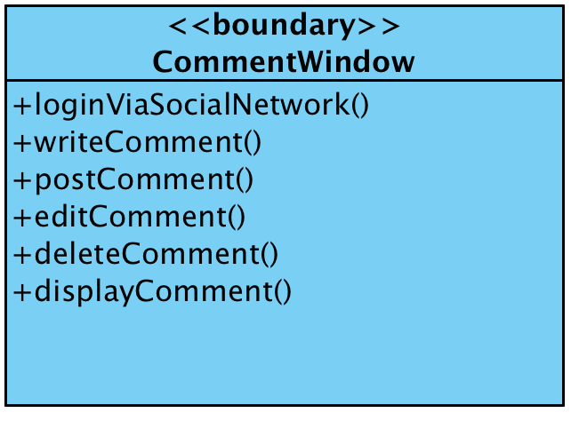
Analysis
Usercase Analysis : View Of Participating Class
Post/Edit/Delete Comment

Slide 33
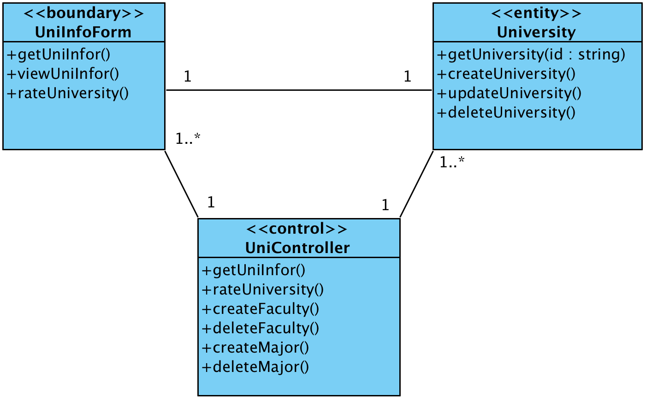
Analysis
Usercase Analysis : View Of Participating Class
View School Information

Slide 34
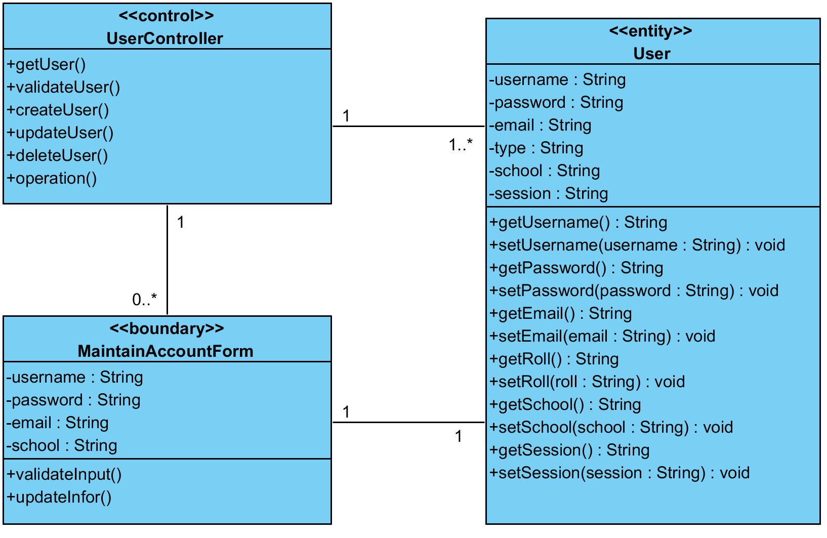
Analysis
Usercase Analysis : View Of Participating Class
Maintain School Account

Slide 35
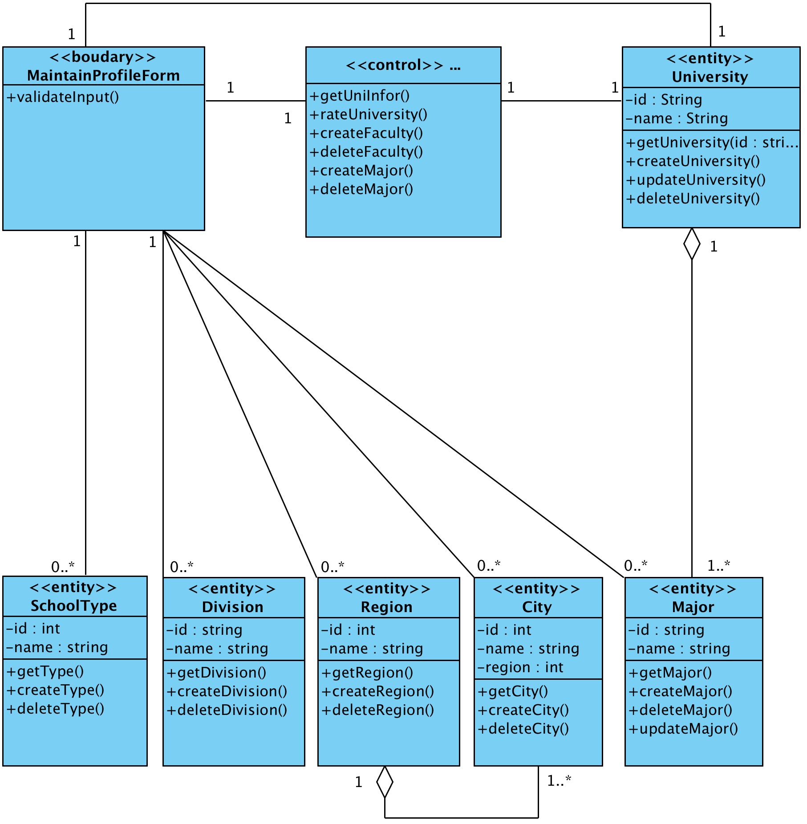
Analysis
Usercase Analysis : View Of Participating Class
Maintain School Profile

Slide 36
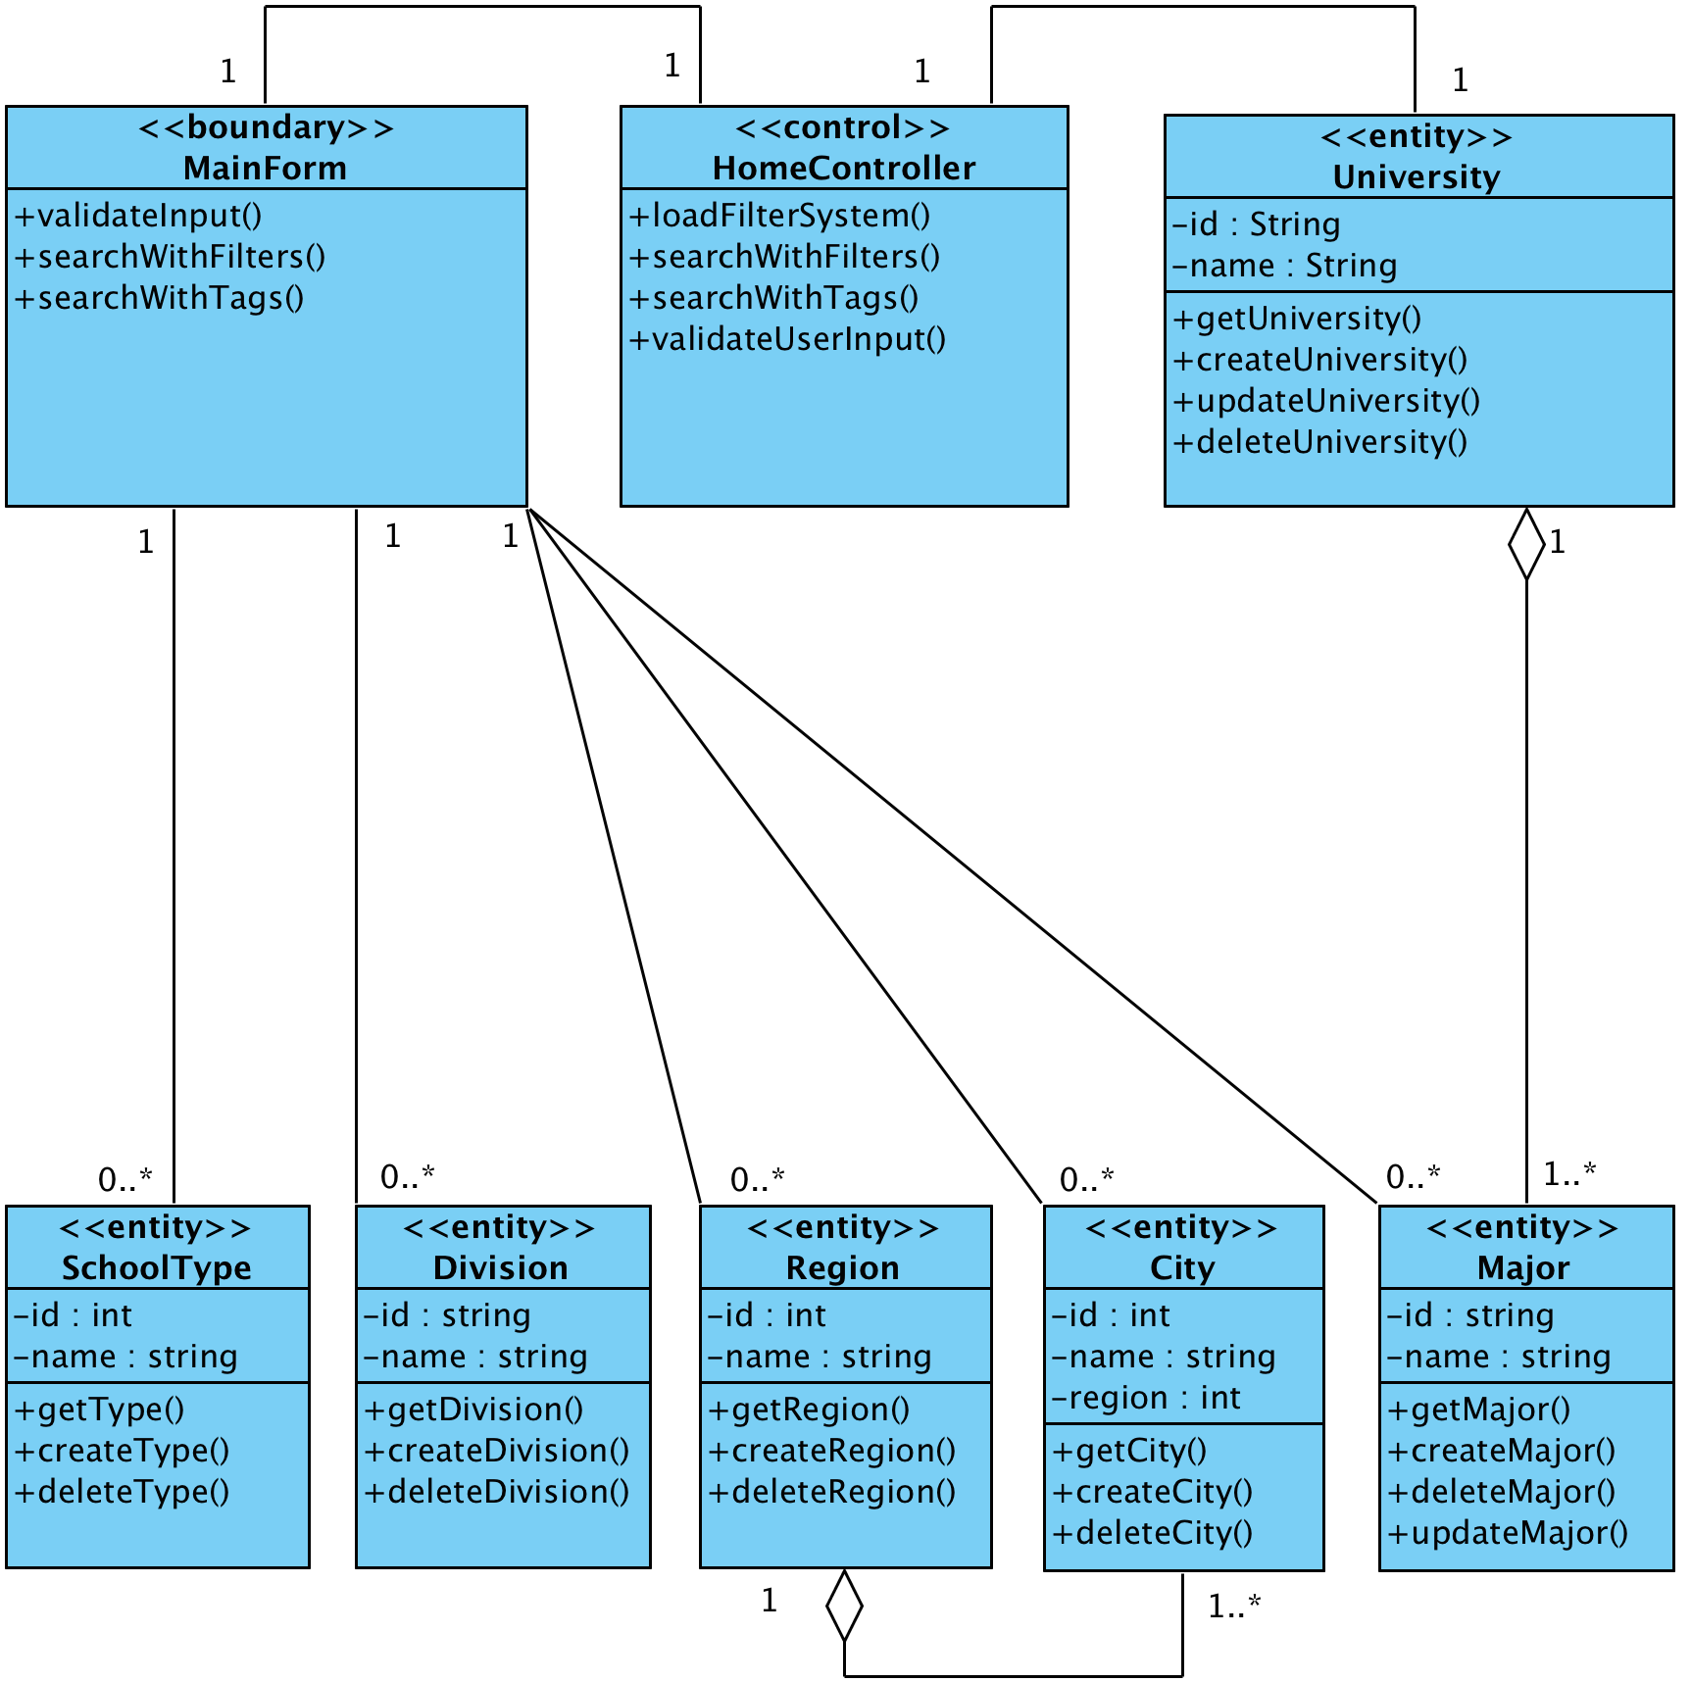
Analysis
Usercase Analysis : View Of Participating Class
Use Filter System

Slide 37
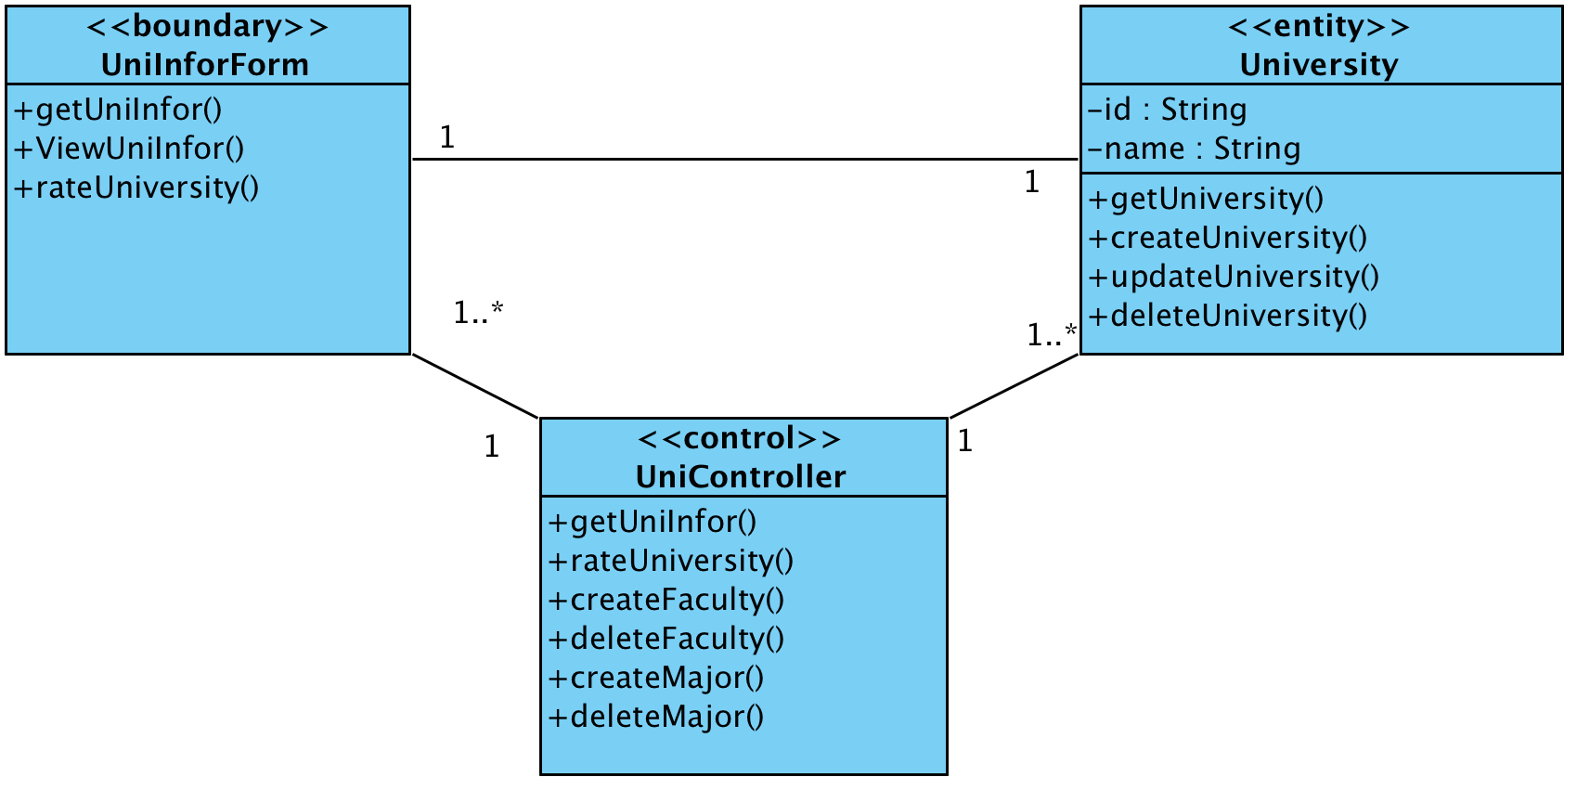
Analysis
Usercase Analysis : View Of Participating Class
Use Rating System

Slide 38
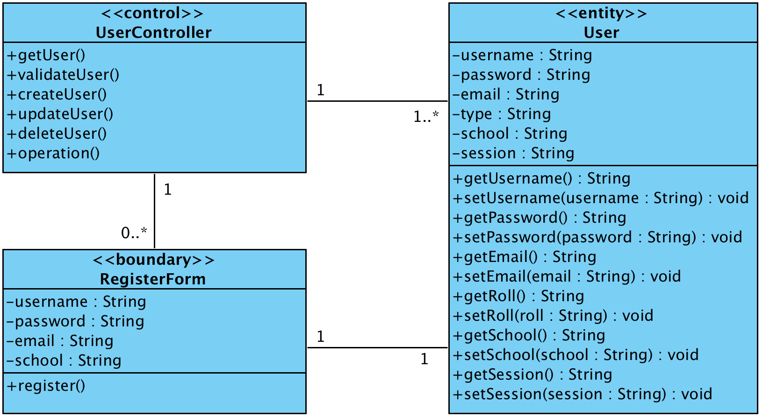
Analysis
Usercase Analysis : View Of Participating Class
Register School Account

Slide 39
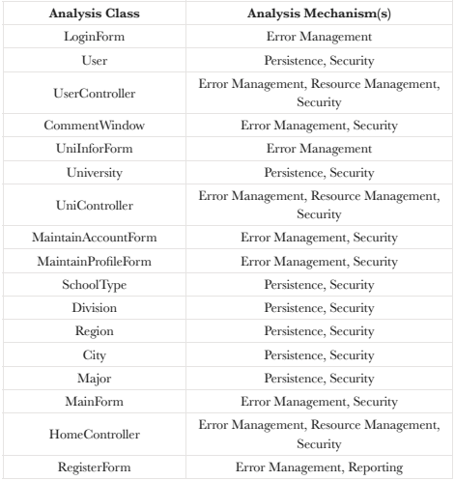
Analysis
Usercase Analysis : Analysis mechanism

Slide 40
Design

Slide 41
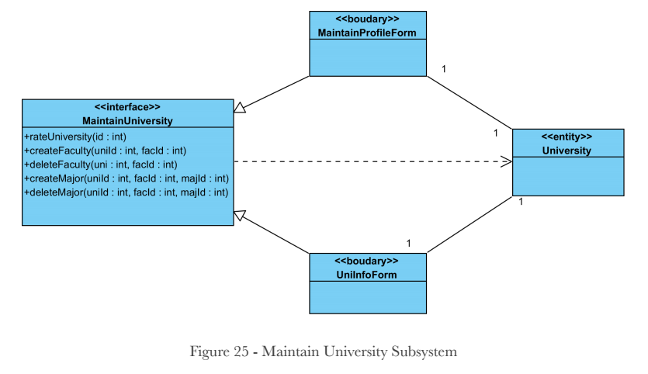
Analysis
Identify Design Element
Subsystem Context Diagram
Notes:
Subsystem Interface Descriptions
MaintainUniversity: encapsulates the action of changing school Faculty, Major
and rating.
rateUniversity: change the school rating with given school id.
createFaculty: make a new faculty for a school with given id.
deleteFaculty: remove a faculty of a school with given id.
createMajor: make a new major for a faculty of a school with given id.
deleteMajor: remove a major of a faculty of a school with given id.

Slide 42
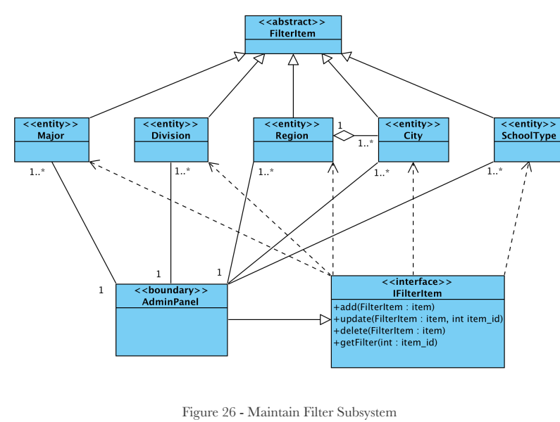
Analysis
Identify Design Element
Subsystem Context Diagram
Notes:
Subsystem Interface Descriptions
IFilterItem: encapsulates the action of add, update, delete or get a filter item.
Data: may be a Major, a Division, a Region, a City or a SchoolType.
add: add an item to the filter.
update: change the item in the filter to the given new item.
delete: remove an item from the filter with given item_id.
getFilter: get an item from the filter with given item_id.

Slide 43
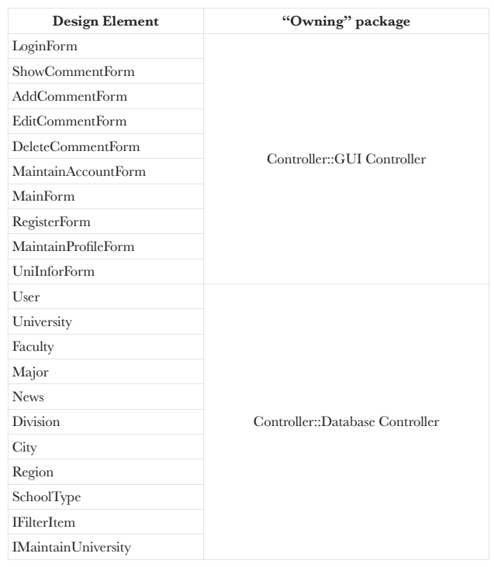
Analysis
Identify Design Element
Design Element to Package map
Notes:
Subsystem Interface Descriptions
IFilterItem: encapsulates the action of add, update, delete or get a filter item.
Data: may be a Major, a Division, a Region, a City or a SchoolType.
add: add an item to the filter.
update: change the item in the filter to the given new item.
delete: remove an item from the filter with given item_id.
getFilter: get an item from the filter with given item_id.

Slide 44
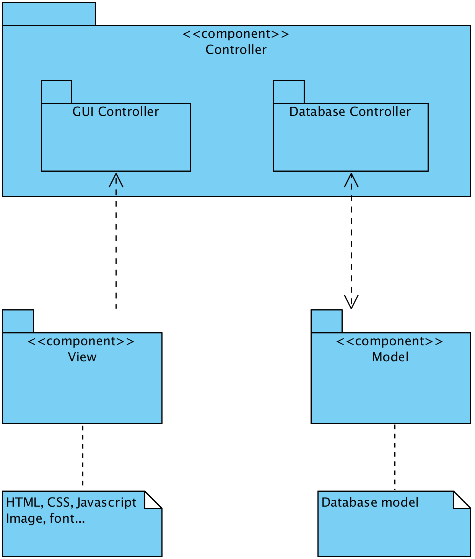
Analysis
Identify Design Element
Architectural Components

Slide 45
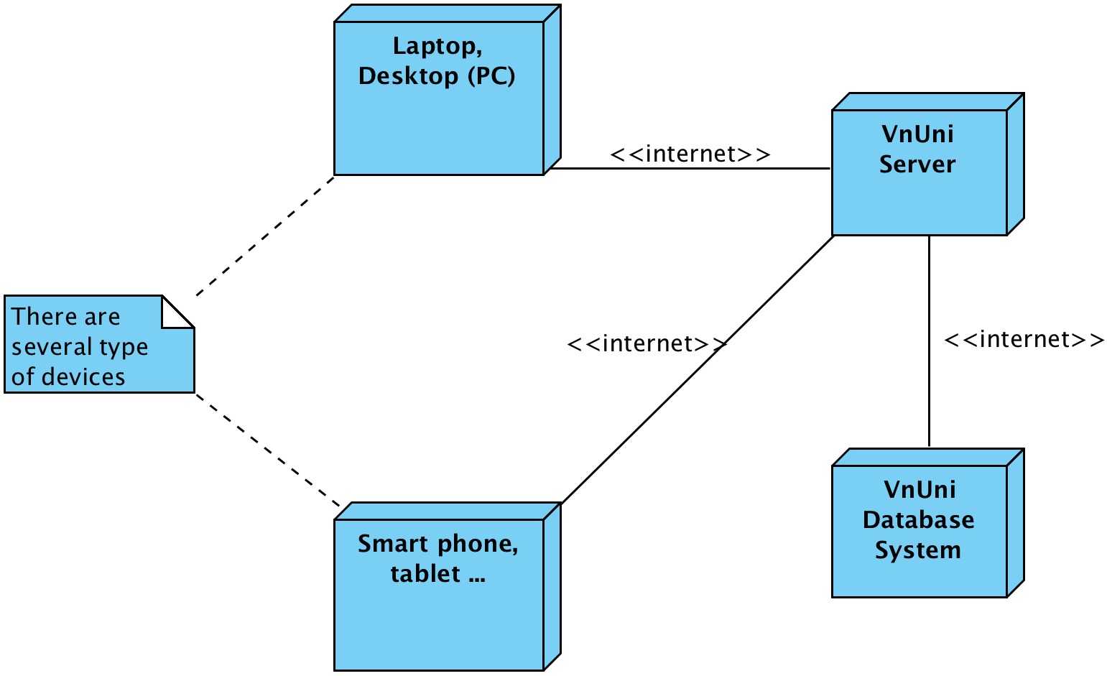
Analysis
Identify Design Element
Describe Distribution

Slide 46
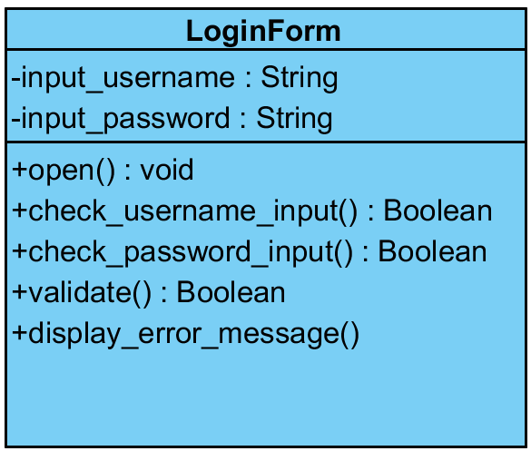
Analysis
Class Design
LoginForm

Slide 47
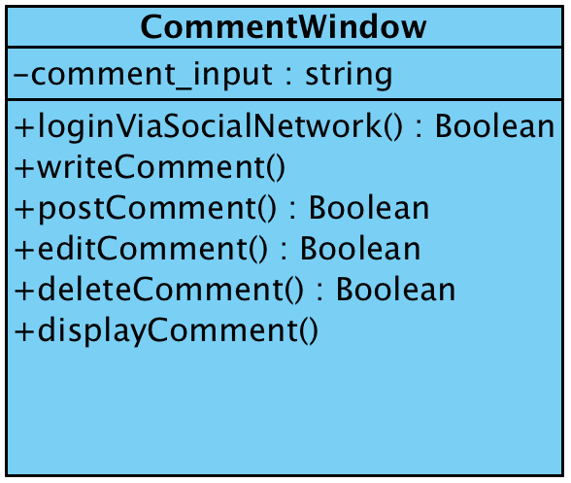
Analysis
Class Design
CommentWindow

Slide 48
Analysis
Class Design
ShowCommentWindow
AddCommentForm
EditCommentForm
DeleteCommentForm
=> Inherit the class “CommentWindow”

Slide 49
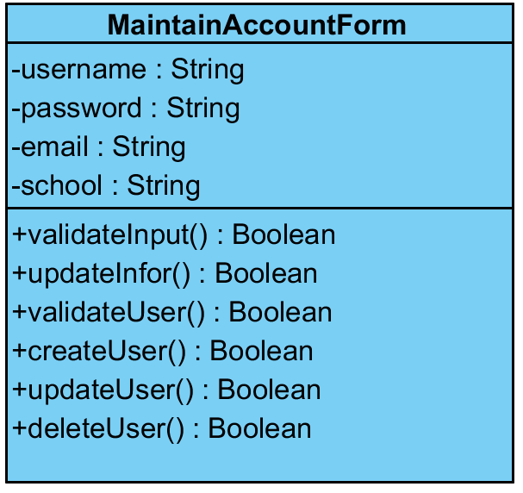
Analysis
Class Design
MaintainAccountForm

Slide 50
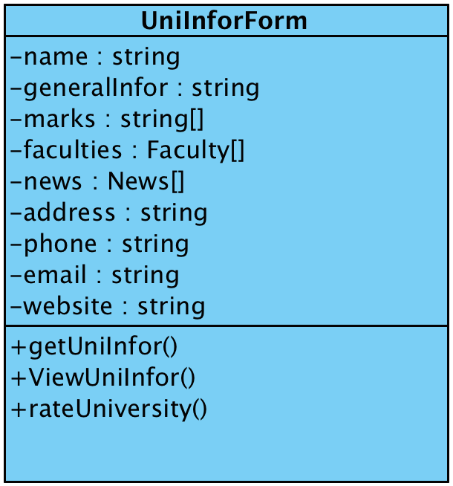
Analysis
Class Design
UniInforForm

Slide 51
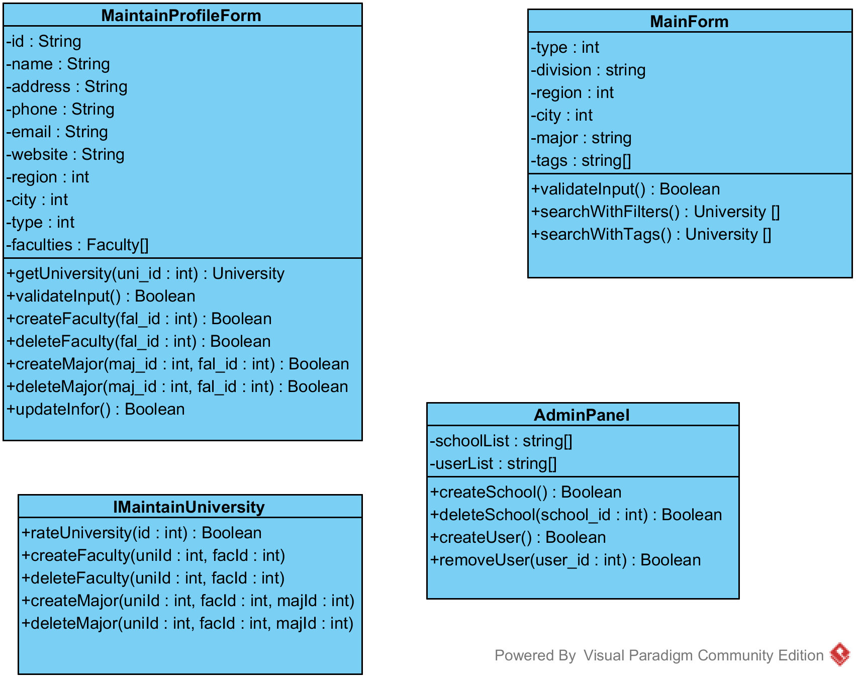
Analysis
Class Design
MaintainProfileForm

Slide 52
Analysis
Class Design
MainForm

Slide 53
Analysis
Class Design
AdminPanel

Slide 54
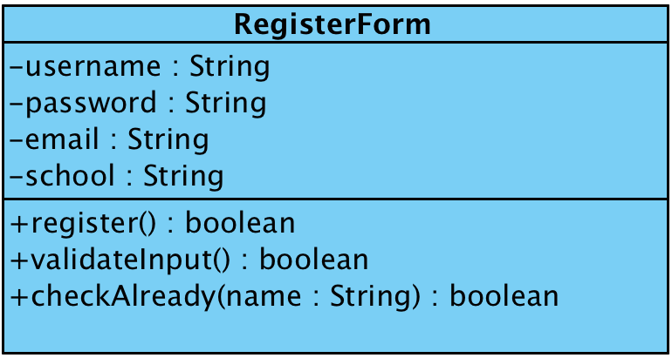
Analysis
Class Design
RegisterForm

Slide 55
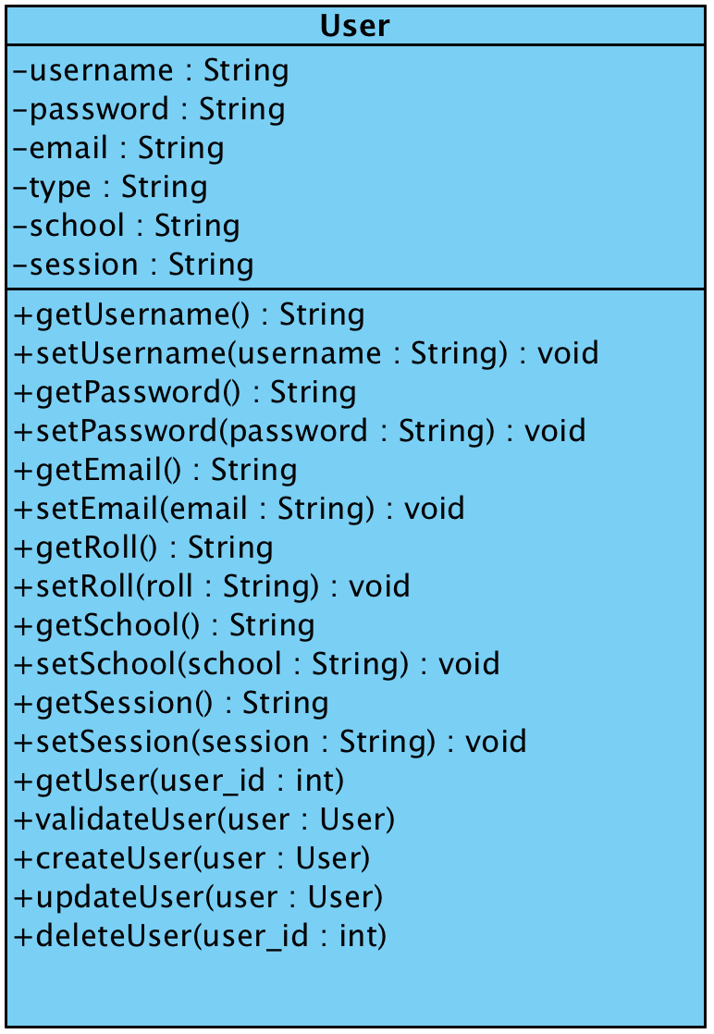
Analysis
Class Design
User

Slide 56
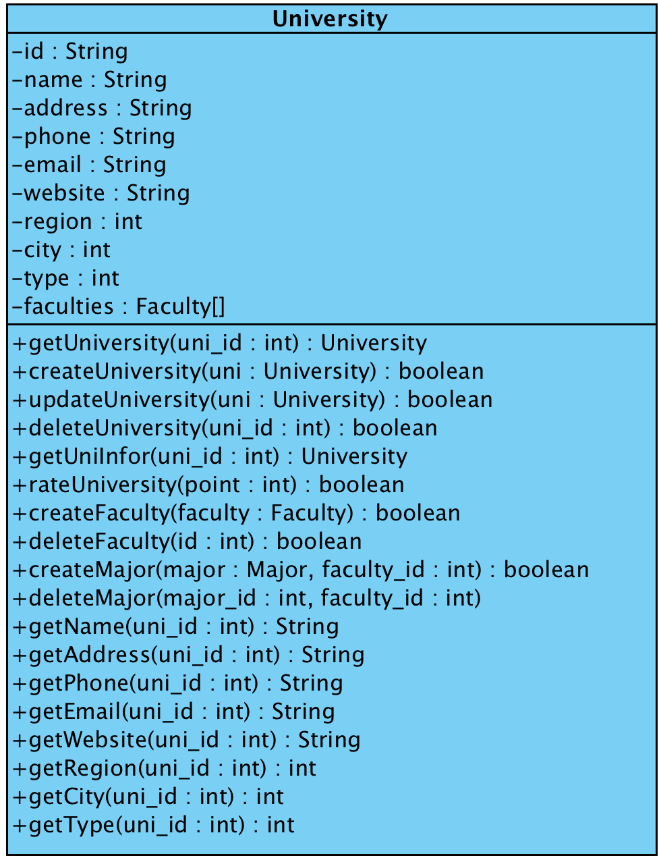
Analysis
Class Design
University
Faculty
Major
Division
Region
SchoolType
City
News

Slide 57
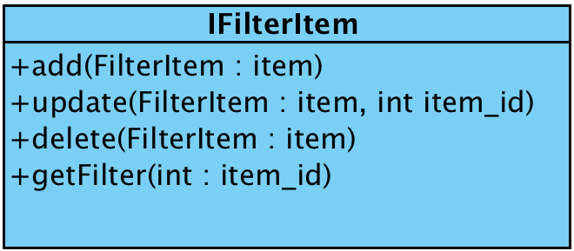
Analysis
Class Design
IFilterItem

Slide 58
Analysis
Class Design
IMaintainUniversity

